Slide 1
Discussion topic for week 2 : Membrane transport
Particle vs continuum description of transport processes.
We will discuss this question in the context of calcium ion channels, which were described using both
  1. continuum (Poisson-Nernst-Planck equations), and
  2. particle approaches (Brownian dynamics).
What are the problems faced by each approach when applied to a narrow channel (diameter < 1 nm)?
(See the web page for papers using each approach)

Slide 2
Diffusion Equations and Applications (Nelson, chap. 4)
Diffusion of particles can be described at many different levels
depending on the context:
Continuum description (Fick’s laws)
Both the particles and the environment are described by continuous densities. Appropriate for many particles.
Particles in a continuum environment (Brownian dynamics)
Motion of particles are traced in a continuum environment using the Langevin equation. Appropriate for few particles.
Particles in a molecular environment (molecular dynamics)
Both the particles and the environment are described at the atomic level using Newton’s eq’n. Necessary for microscopic systems.

Slide 3
Continuum description of diffusion
We need to derive a differential equation for this purpose.
Divide a box of particles into small cubic bins of size L

x-L x x+L
j: flux of particles (number of particles per unit area per unit time)
c: concentration of particles (number of particles per unit volume)
Random walk in 1D; half of particles in each bin move to the left and
half to the right.
j₊
j−

Slide 4
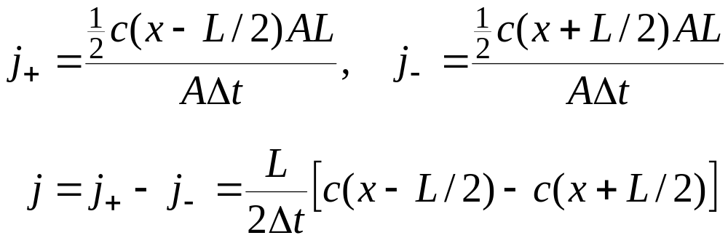
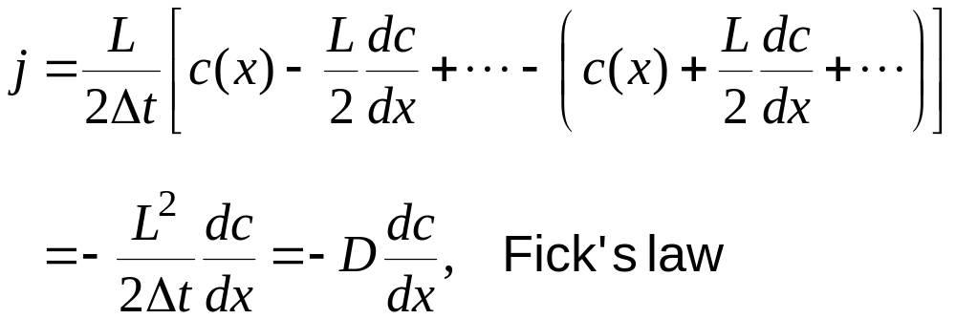

Right, left and total fluxes at x are given by
Taylor expanding the concentrations for small L gives
Generalise to 3D:
Flux direction: particles move from high concentration to low concentration

Slide 5
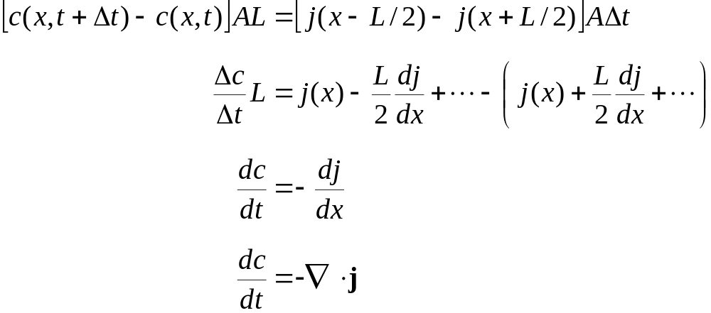
Conservation laws:
Total number of particles is conserved.
If there is a net flow of particles inside a bin, j j
the concentration inside must increase by
the same amount.
x-L/2 x x+L/2
Generalise to 3D:
c(x,t)
(similar to charge conservation)

Slide 6
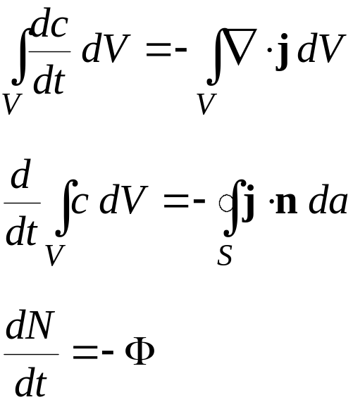
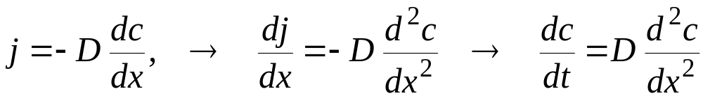
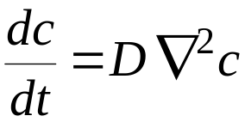
Integrate the conservation equation over a closed volume V with N part’s
(Divergence theorem)
(rate of change of N = − total flux out)
We can use the conservation equation to eliminate flux from Fick’s eq’n.
Generalise to 3D: (analogy with the Schroedinger Eq.)
Fick’s 2nd law
Diffusion eq.

Slide 7
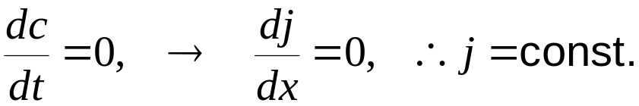
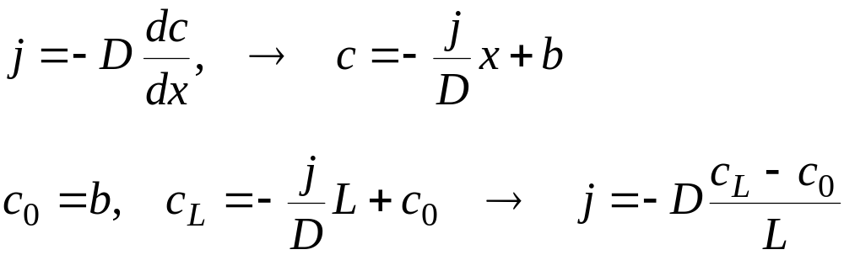
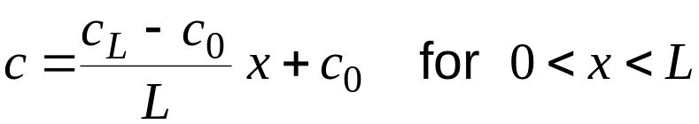
Once the initial conditions are specified, the diffusion equation can be
solved numerically using a computer.
Special cases:
Equilibrium: c(x)=const. → j = 0, c is uniform and constant
Steady-state diffusion: c(x) = c₀ for x < 0 and c(x) = c_{L} for x >L
No time dependence,

Slide 8
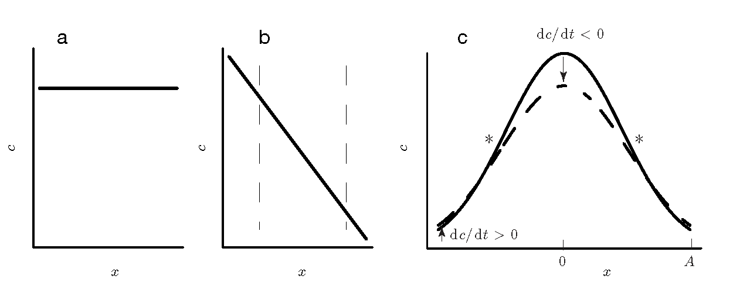
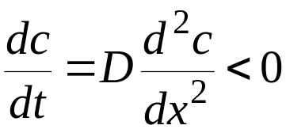
Uniform Steady-state Time dependent
Time dependent cases:
if c is at a maximum. Hence c will decrease in time.
2nd law of thermodynamics: entropy in a closed system increases.

Slide 9
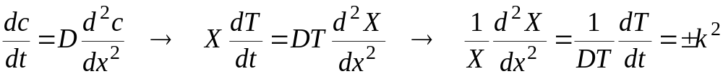
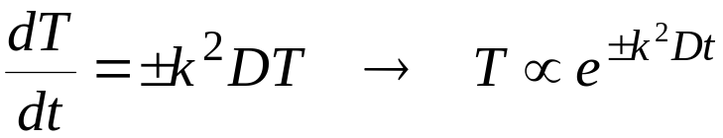
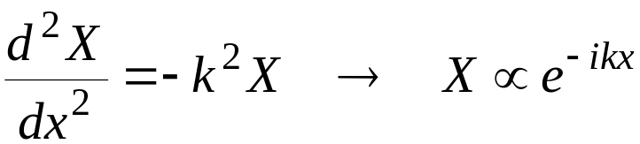
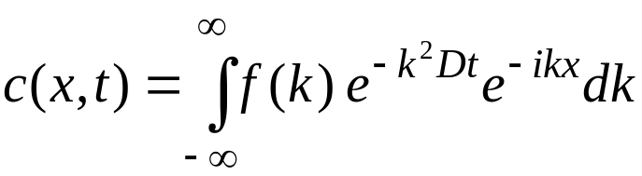
Solution of the diffusion equation
Separation of variables: c(x,t) = X(x)T(t)
Time solution:
Reject the + sign because it diverges as t → ∞
Space solution:
Superposing, we obtain for the general solution:

Slide 10
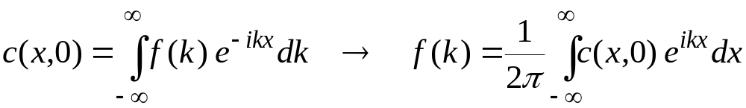
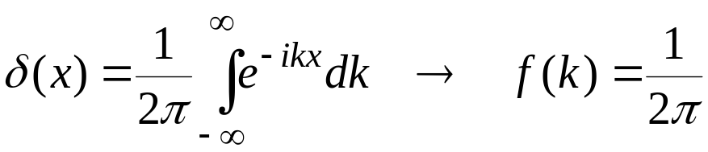
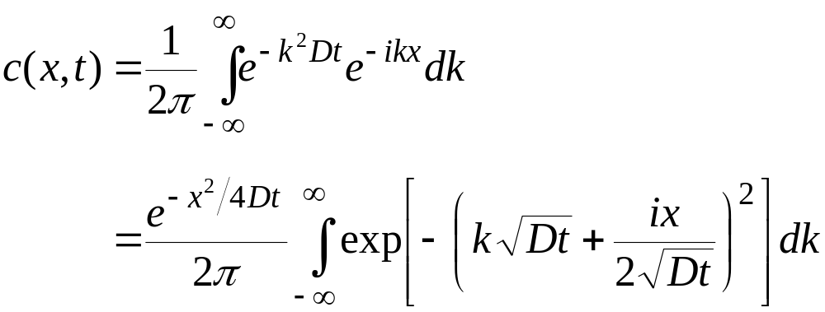
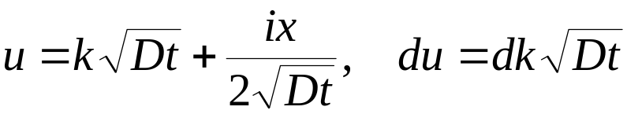
The function f(k) is determined from the initial conditions via inverse FT
Special case: pulse solution, c(x,0) = δ(x)
Substitute

Slide 11

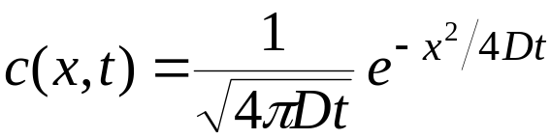
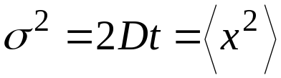
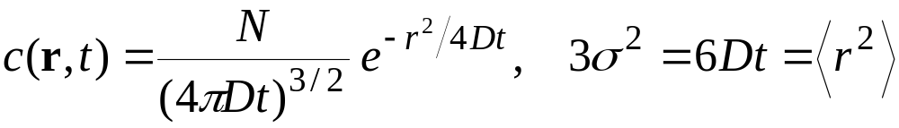
The Gaussian integral gives so that
which is the Gaussian distribution with
This is for 1 particle. For N particles multiply c(x,t) by N.
Generalization to 3D (for N particles)
With time, particles spread and the concentration dist. becomes flatter.
Pulse solution provides a good description for the diffusive motion of
molecules released from vesicles in cells (e.g. neurotransmitters).

Slide 12
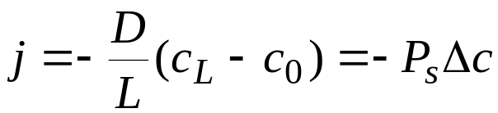
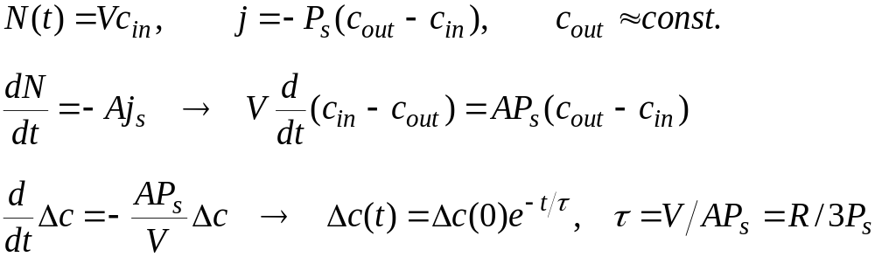
Applications of diffusion in biology
1. Solute transport across membranes
Steady-state diffusion in pores
where P_{s} is the permeability of the membrane
Cells have a small volume compared to outside, hence any imbalance
in c_{in} and c_{out} will not last long
e.g. for alcohol, τ ≈0.2 s (D≈10⁻⁹ m²/s, L≈5x10⁻⁹ m, R ≈10⁻⁵ m, α=10⁻⁴)

Slide 13
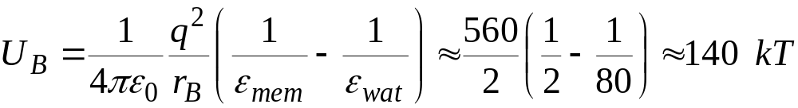
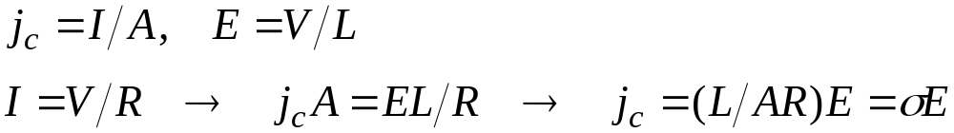
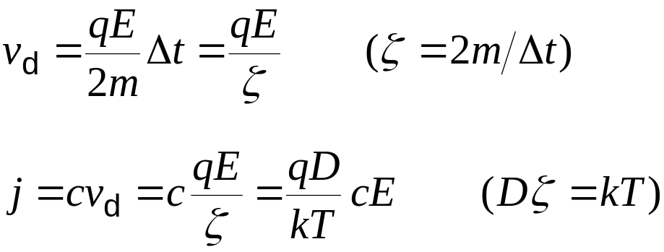
2. Charge transport across membranes (ion channels)
Born energy;
Hence water filled pores are needed to transport ions across membranes
Macroscopic observation: Ohm’s law I = V/R works well in ion channels
For a cylindrical pore with length L and area A, we have
Microscopics:
Drift velocity
Flux (number)

Slide 14
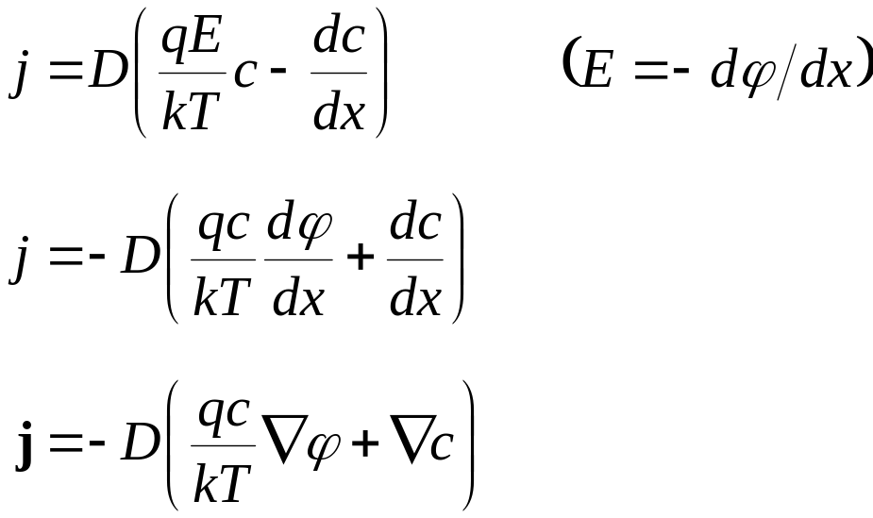
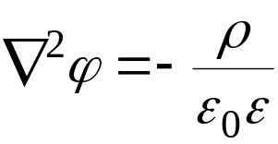
Combine Ohm’s and Fick’s laws
Given the charge dist. ρ = qc, we solve the Poisson eq. for the potential
For consistency the Poisson and Nernst-Planck eq’s. need to be solved
simultaneously (PNP equations)
Nernst-Planck equation
Generalization to 3D

Slide 15
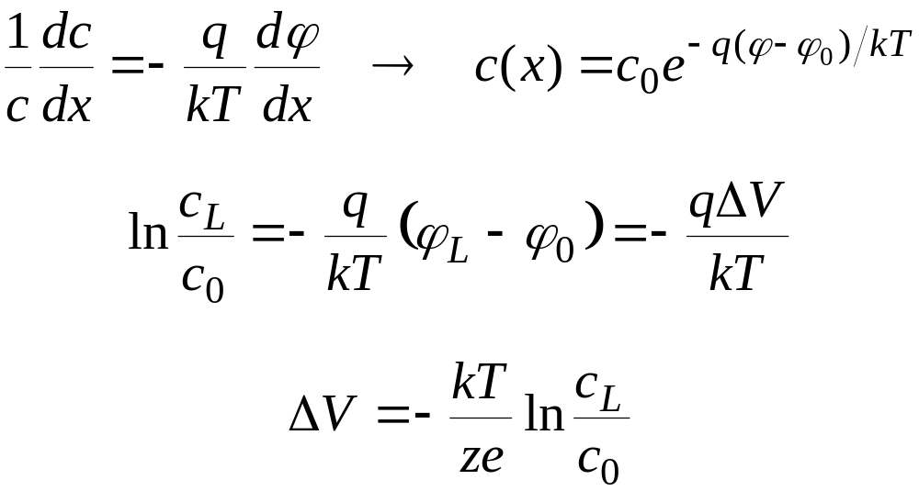
Solutions in 1D:
1. Equilibrium (j = 0)
Integrate [0, L],
At room temperature, kT = 1/40 eV, hence kT/e = 25 mV
A typical 10-fold difference in concentrations leads to ΔV = −58 mV
Note that if cell membranes were equally permeable to all ion types,
there would be no potential or concentration difference. Nernst potential
arises because they are selectively permeable to ions.
Boltzmann dist.
Nernst potential

Slide 16
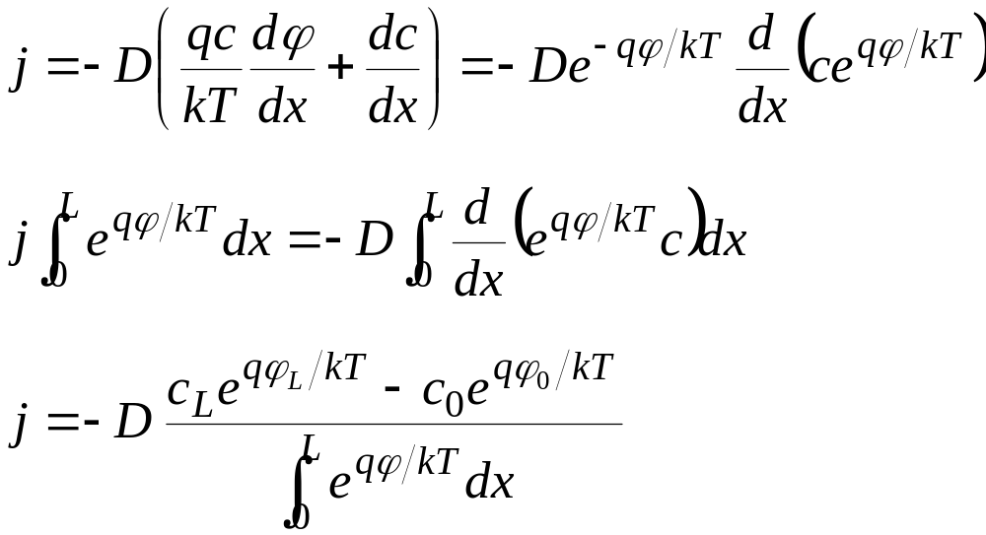
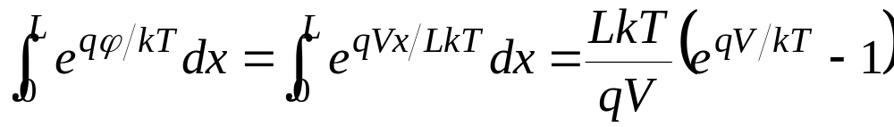
2. Steady state (j = const.)
No known integrals of exp. of a function other than linear! (uniform E field)
Let,

Slide 17
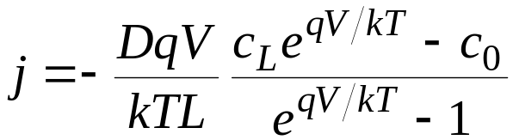
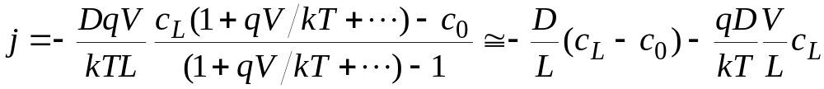
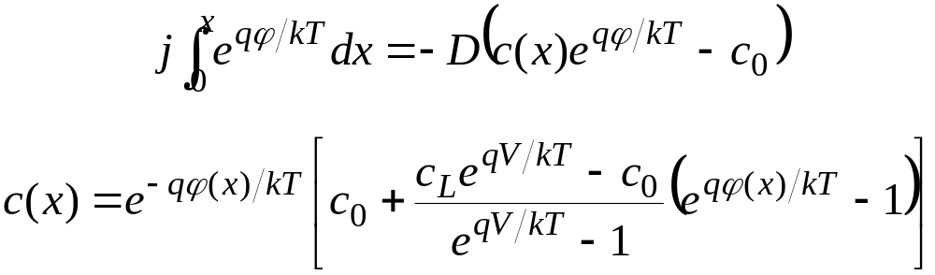
Substituting in the flux gives
For qV/kT << 1, we can linearize the GHK eq.
To find the concentration, integrate [0, x] instead of [0, L]
GHK eq. (Goldman-Hodgkin-Katz)

Slide 18
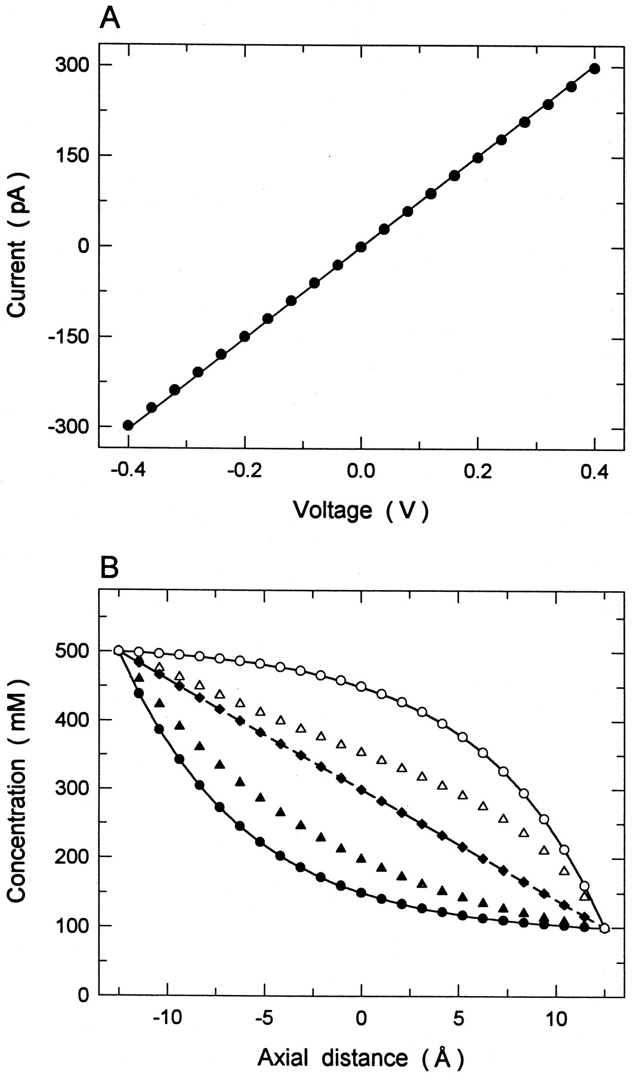
Results of PNP calculations in
a cylindrical channel:
A. Symmetric solutions with 300 mM
NaCl on both sides. I-V curve follows
Ohm’s law
B. Asymmetric solutions with
c₀ = 500 mM and c_{L} = 100 mM
V = −100 mV (V = 0, central line)
Solid lines: GHK eq.
Circles: NP eq’s. with uniform E
Diamonds: self-consistent PNP eq’s.
Cl
Na

Slide 19
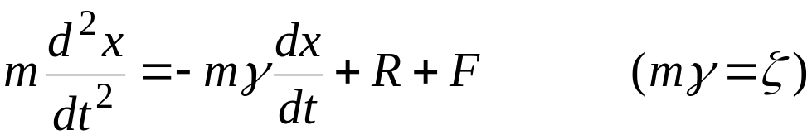
Particle description of diffusion (Brownian dynamics)
The continuum description is fine when many particles are involved.
But when there are only a few particles, their interactions with each other and boundaries are not properly described.
In that situation, a particle based approach is more reliable. The rest of the system is still treated as continuum with dielectric constants.
Examples:
transport of ions in electrolyte solutions (water is in continuum)
protein folding and protein-protein interactions (water is in continuum)
ion channels (water, protein and lipid are in continuum)
To include the effect of the atoms in the continuum, modify the Newton’s
eq. of motion by adding frictional and random forces:
Langevin equation:

Slide 20
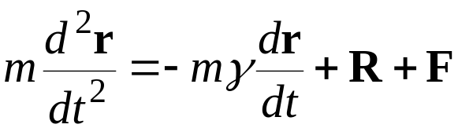
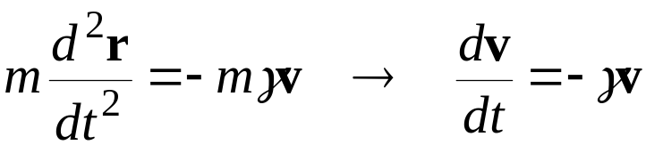

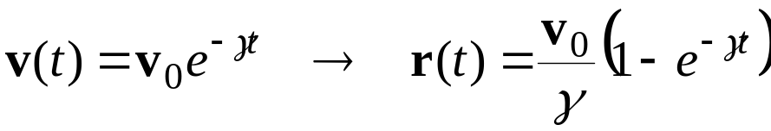
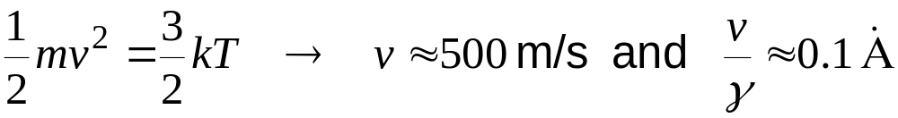
Generalization to 3D:
Frictional forces:
Friction dissipates the kinetic energy of a particle, slowing it down.
Consider the simplest case of a free particle in a viscous medium
Solution with the initial values of
In liquids frictional forces are quite large, e.g. in water γ ≈ 5x10¹³ s⁻¹
From

Slide 21


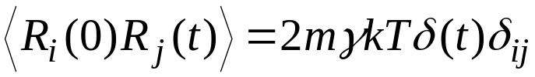
Random forces:
Frictional forces would dissipate the kinetic energy of a particle rapidly.
To maintain the average energy of the particle at 1.5 kT, we need to kick it with a random force at regular intervals.
This mimics the collision of the particle with the surrounding particles, which are taken as continuum and hence not explicitly represented.
Properties of random forces:
Must have zero mean (white)
2. Uncorrelated with prior velocities
3. Uncorrelated with prior forces
(Markovian assumption)

Slide 22
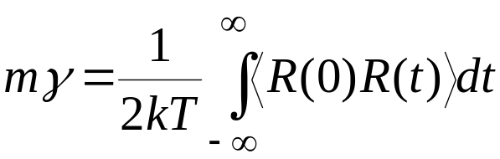


Fluctuation-dissipation theorem:
Because the frictional and random forces have the same origin,
they are related
t
In liquids the decay time is very short, hence one can approximate the correlation function with a delta function

Slide 23
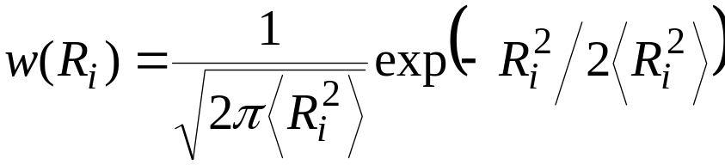
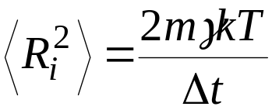
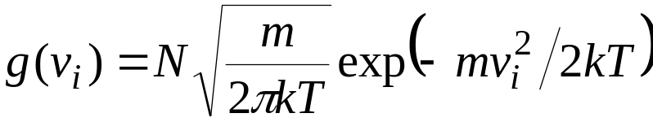
Random forces have a Gaussian probability distribution
This follows from the fact that the velocities have a Gaussian distribution
In order to preserve this distribution, the random forces must be distributed likewise.

Slide 24
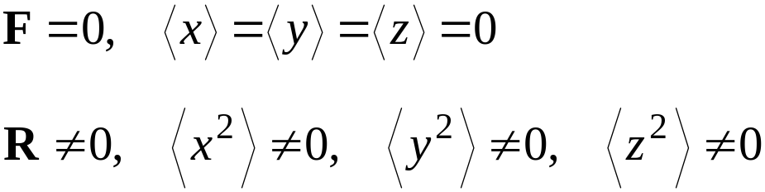
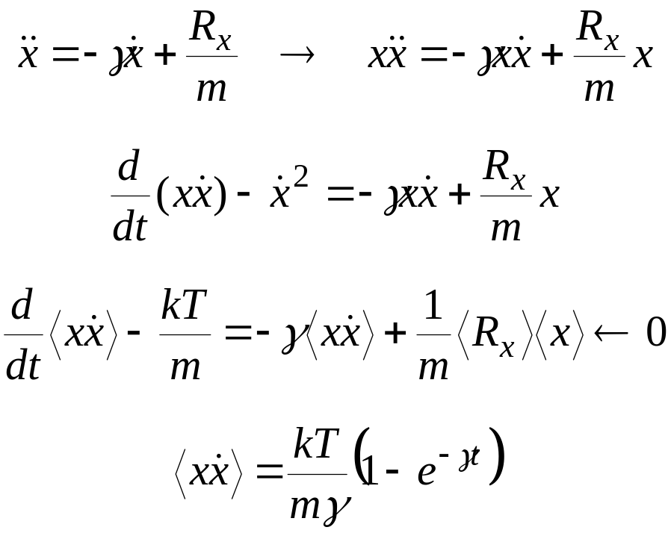
A simple example: force-free particle (F = 0)
Since
But because
Consider the x direction
Ensemble average
Integrate

Slide 25
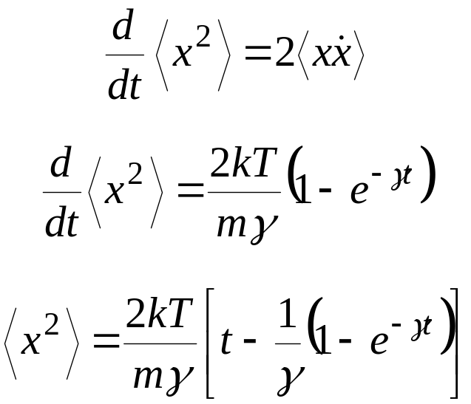
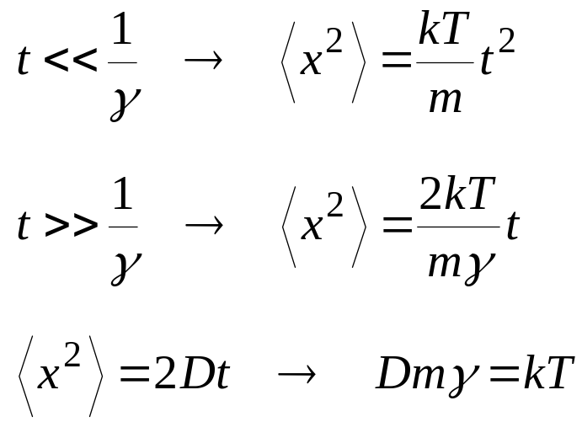
Using
gives
Consider the limits
1. Ballistic limit:
2. Diffusion limit:
Fick’s law
Einstein relation

Slide 26

Integration algorithms
More complicated because one has to integrate over the random force.
The simplest is a leap-frog algorithm
This algorithm is alright for short time steps, i.e. a few fs (10⁻¹⁵ s)
Longer time steps are possible but one needs to use a more accurate (higher order) integration algorithm.

Slide 27
Statistical analysis of trajectory data
A typical simulation consists of two stages:
Equilibration
Production run
The trajectory data generated during the production run is used in statistical analysis of the system:
Thermodynamic average and standard deviation (fluctuations)
Pair distribution functions (structural information)
Time correlation functions (dynamical information)
Ergodic theorem: ensemble average = time average

Slide 28
Validity of the continuum theories in nano-pores
In continuum theories, dielectric self-energy is not properly accounted for
Induced charges
at the water-protein interface
ε = 80
ε = 2
+
+
+
+
+
+
+
Image force on an ion
water
protein
When an ion is pushed in to the channel, an image force pushes it out

Slide 29


A simple test of PNP equations in a cylindrical channel
Control study:
Set artificially ε = 80 in the protein. No induced charges on the
boundary, hence no discrepancy between the two methods
regardless of the channel radius. (C=300 mM, V=100 mV)
G_{norm}=G/πr²
r = 4 Å
Cl ⁻
Na ⁺

Slide 30


In the realistic case (ε = 2 in the protein), ions do not enter the channel in BD due to the dielectric self-energy barrier.
Only in large pores (r > 10 Å), validity of PNP is restored.
(C=300 mM, V=100 mV)
G_{norm}=G/πr²
r = 4 Å

Slide 31


Comparison of PNP and BD concentrations in r=4 Å channel
PNP
ΔC=400 mM
V=0
BD
C=300 mM
V=100 mV

Slide 32
Physical picture
Discrete ions in BD
Narrow pore Large pore
+
-
+
+
+
+
+
-
-
-
+
+
+
+
+
+
+
+
-
-
+
+
+
+
+
-
+
+
+
+
-
Continuous ion densities in PNP have the same picture
regardless of the pore size

Slide 33

Action potential
Problem of signal transmission in salt water
Diffusion wouldn’t work: <x²>=2Dt, D~10⁻⁹ m²/s, t~ years!
Solution: change the membrane potential in axons, and propagate the resulting potential spike.

Slide 34

Ion channels & action potential
Na⁺ concentration is high outside cells and low inside.
Vice versa for K⁺ ions. Membrane potential, V_{mem} = −60 mV.
When Na channels open, Na⁺, ions rush in, V_{mem} collapses.
The potential drop triggers K channels open, K⁺ ions move out,
and V_{mem} is restored.
Out
In

Slide 35

Synapses & neuron communication

Slide 36

BD description of calcium channel (video)
Model inspired by the KcsA potassium channel, modified to accommodate
experiments and molecular models.
Inside
Outside
8 Å
5.6 Å
4 glutamate
residues
4 dipoles
50 Å
Selectivity filter is characterised by the mutation data and permeant ions

